Slide 1




HOMEOPATHIC
MEDICINE
ANALYSIS

Slide 2

INTRODUCTION
Consultancy firm assisting a client in opening a homeopathic medicine store.
Database with two essential tables for medical information.
Goal: Develop an interactive dashboard for client use.
Dashboard Insights:
Number of medicines categorized by benefit areas.
Price ranges analysis.
Brand specialization overview.
Ingredient analysis for medicines.
Average cost estimation for ingredients.
Identification of highly-rated medicines.
Purpose: Enable informed stocking decisions for the client's store.

Slide 3
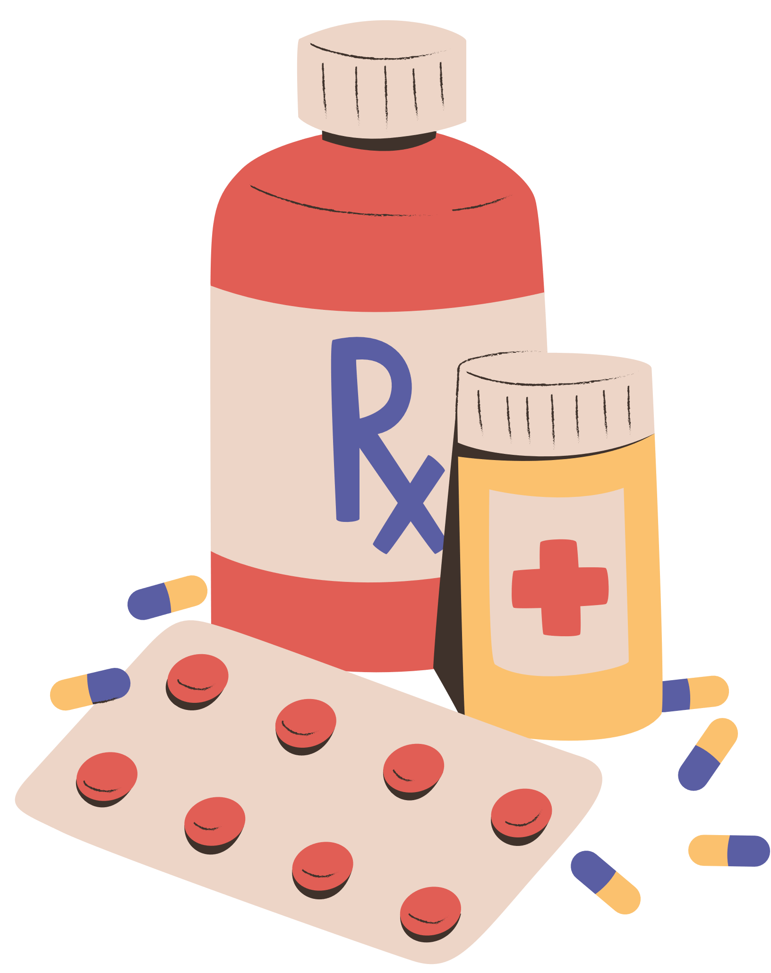
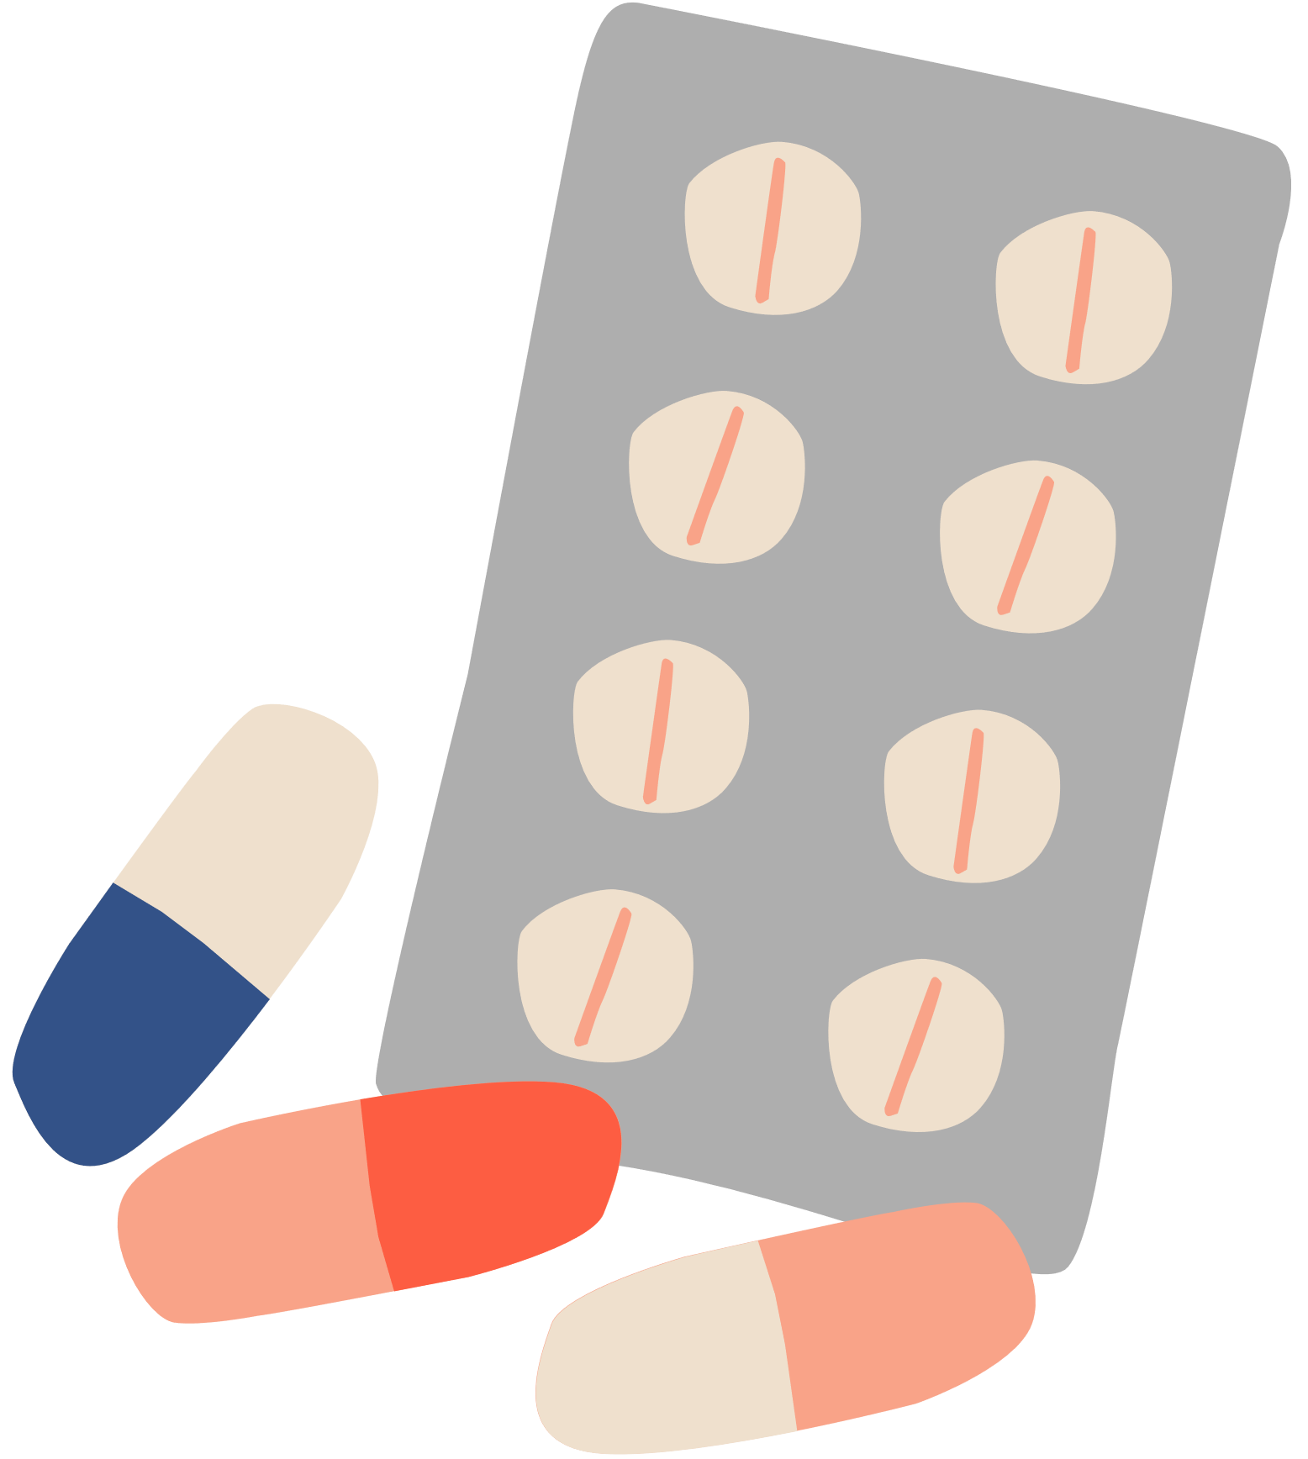
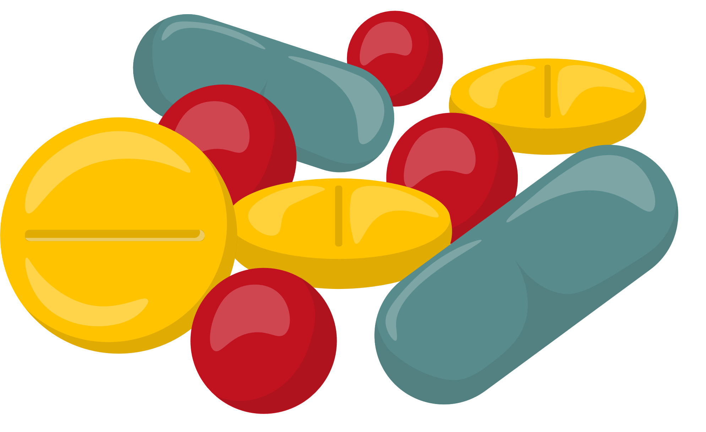
PROJECT EXECUTION
SCRAPPING (USING PYTHON & BEAUTIFUL SOUP
ANALYSIS & FILTERING
PRESENTAION

Slide 4

INSIGHTS
•Most sold medicine - Bakson’s Fevo Aid Syrup
•Most used ingredient – Lycopodium Clavatum
•Most common specific area – Eyes
•Most reviewed brand – SBL Private Ltd
•Average MRP of medicine – RS 181
•Average cash generation per sale – RS 163

Slide 5
count
25,000
20,000
15,000
10,000
5,000
0
Others
Eye
Joints
Skin
Throat
Heart
Head
Kidney
Hair
Nerves
Brain
Whole Body
Stomach
Intestine
Pancreas
Number of medicine available of different benefit area.

Slide 6
Nerves
2.7%
Eye
16.8%
Hair
4.2%
Kidney
4.9%
Head
5.1%
Joints
13.5%
Stomach
5.9%
Heart
7.3%
Whole Body
11.4%
Throat
9.7%
Skin
11.2%
Maximum number of times ingredient used in each benefit area..

Slide 7

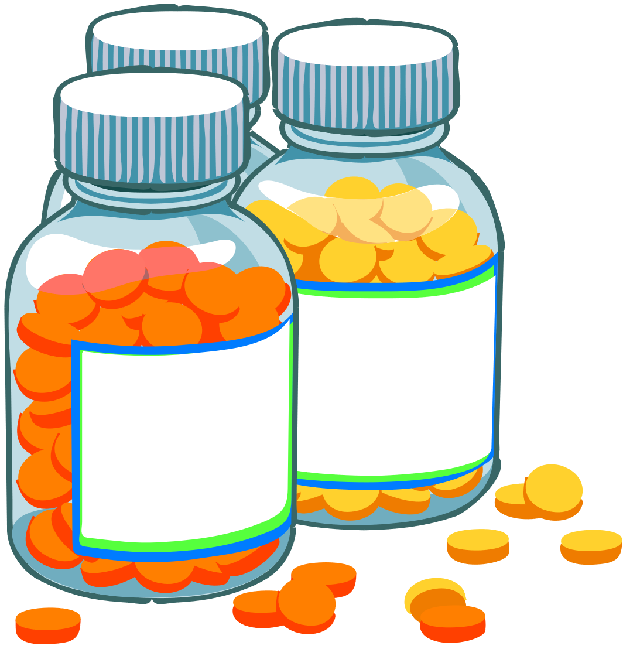
Our approach toward the Analysis
Sale Insights:
Higher sales of throat and head medicines indicate potential pollution or high population density areas, e.g., Mumbai and Delhi.
Inventory Strategy:
Consider stocking a significant inventory in areas like Mumbai and Delhi due to high demand for throat and head medicines.
Urban Market Preferences:
Metropolitan cities (e.g., Mumbai, Bangalore, Chennai) with a corporate youth population tend to prefer ayurvedic ingredient-based medicines, so factor this into store offerings.
Western States Focus:
In states like Gujarat and Rajasthan, where a majority are vegetarians, prioritize natural medicines in the inventory.

Slide 8

Northern States Approach:
Northern states like Haryana and Punjab prefer homemade desi remedies (dadi ke nuskhe), so focus on creating brand awareness and value in these regions.
Brand Impact and 1mg:
Highlight the success of 1mg, especially since it's a part of the TATA group, as an example of a company doing well across different regions.
Revolutionary Change:
Acknowledge the positive impact of companies like 1mg in revolutionizing doorstep medical services, emphasizing the importance of such services in the industry.

Slide 9
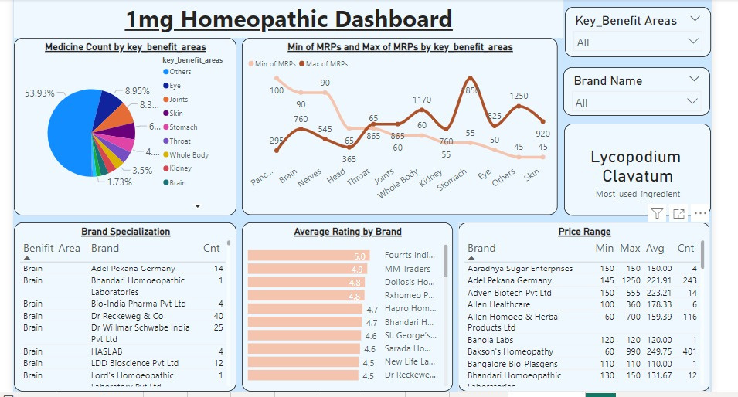
DASHBOARD

Slide 10



CHALLENGES FACED
CHALLENGES FACED DURING THE PROJECT:
LEARNING OF A NEW SKILL: WEB SCRAPPING (OPPORTUNITY AS WELL AS A CHALLENGE)
TIMING: SOME OF THE MEMBERS OF OUR GROUP WERE WORKING PROFESSIONALS AND SOME WERE FULL-TIME STUDENTS COLLABORATING AT A PARTICULAR TIME WAS A BIT OF A CHALLENGE.
DATA WAS TOO BIG TO RETRIEVE WE GOT DISCONNECTED FROM THE COMPANY’S SERVER A NUMBER OF TIMES.
REQUIREMENT OF A STABLE NETWORK.
FACE OFF WITH A REAL-LIFE PROJECT WAS CHALLENGING BUT GOT OUR HANDS ON THE TOOLS WELL.

Slide 11
THANK YOU

